Slide 1

Anonymous Functions
Professor Bo Liu
James Watt School of Engineering

Slide 2
Anonymous functions
Accept multiple input arguments and return one value.
Contain one expression, the result of which is returned as the output of the function (no output is explicitly defined).
Can be defined at any point in a script.
Anonymous functions are MATLAB functions that are defined "Inline" as opposed to in a separate file or at the bottom of a script.
Can be used as function handles (function pointers).

Slide 3

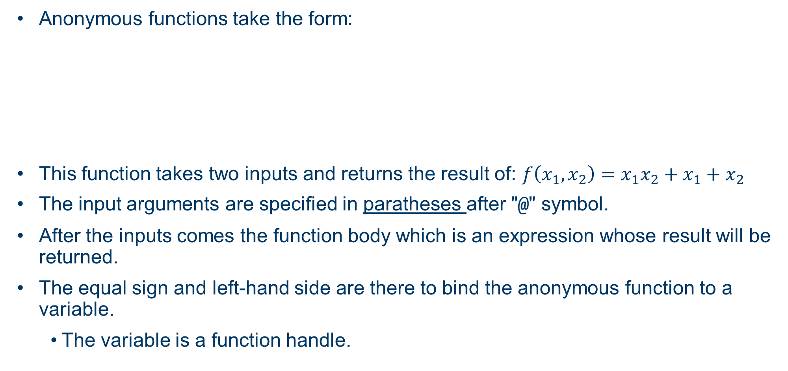
Anonymous functions
Anonymous functions take the form:
This function takes two inputs and returns the result of: $f\left(x_{1},x_{2}\right)={x_{1}x_{2}+x}_{1}+x_{2}$
The input arguments are specified in paratheses after "@" symbol.
After the inputs comes the function body which is an expression whose result will be returned.
The equal sign and left-hand side are there to bind the anonymous function to a variable.
    The variable is a function handle.
Function name
Input arguments
Function body
See live script

Slide 4

Calling anonymous functions
After an anonymous function is bound to a variable, it can be called like any other MATLAB function:
The anonymous is stored as a variable and can be found in the Workspace.
Since anonymous functions contain only one expression, they are best suited to simple mathematical functions.
  Useful when a specific expression needs to be repeated over and over within the same script.
See live script

Slide 5
Passing anonymous functions to other functions
The function handle variable, can be passed into another function as an argument.
For example, a function that takes the input function ("func") and applies it to every element of the input 1 dimensional array ("vecIn"):
function vecOut = applyToVec(vecIn, func)
vecOut = zeros(1,length(vecIn)); % initialise output vector
for i=1:1:length(vecIn)
vecOut(i) = func(vecIn(i));
end
end
Here the func argument should be a function handle to a function that should be applied to every element of the input vector.
See live script

Slide 6
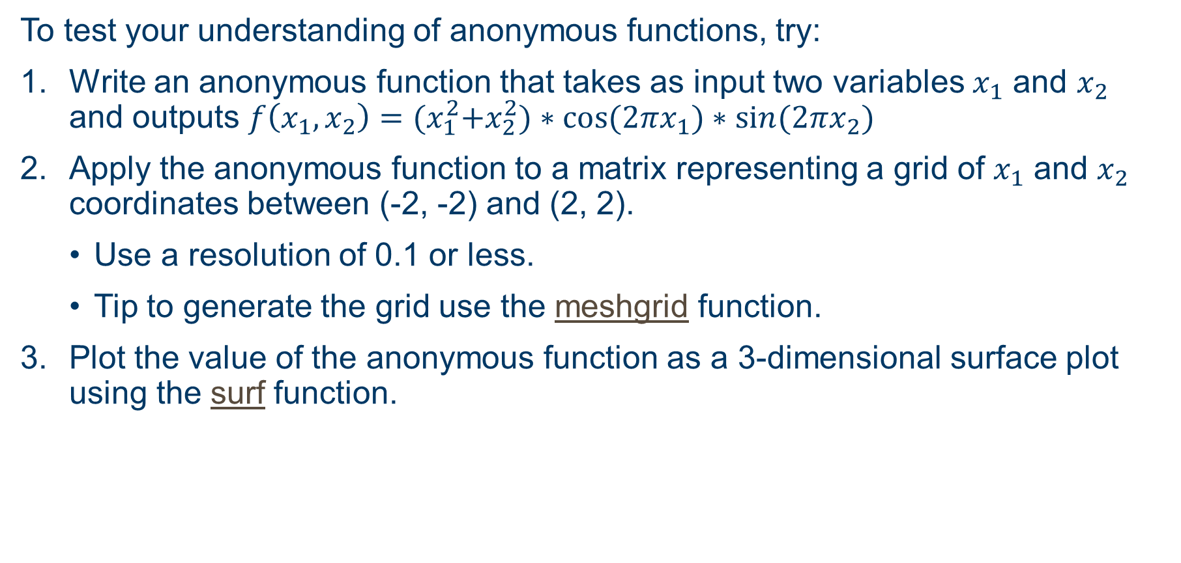
Exercise: Anonymous functions
To test your understanding of anonymous functions, try:
Write an anonymous function that takes as input two variables $x_{1}$ and $x_{2}$ and outputs $f\left(x_{1},x_{2}\right)={(x}_{1}^{2}+x_{2}^{2})∗\cos{(2πx_{1})}∗\sin{(2πx_{2})}$
Apply the anonymous function to a matrix representing a grid of $x_{1}$ and $x_{2}$ coordinates between (-2, -2) and (2, 2).
  Use a resolution of 0.1 or less.
  Tip to generate the grid use the meshgrid function.
Plot the value of the anonymous function as a 3-dimensional surface plot using the surf function.

Slide 7
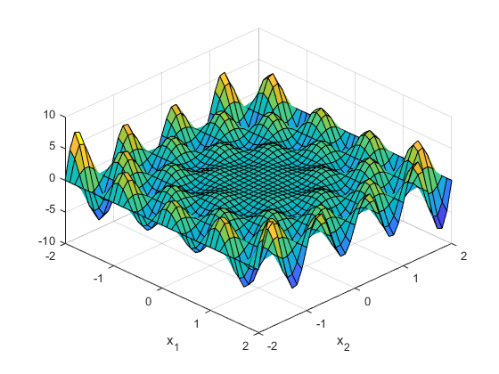
Exercise: Anonymous functions solution plot
The plot resulting from this exercise should look like:
Answers in live scripts.

Slide 8




Thanks!
#UofGWorldChangers
@UofGlasgow

